Slide 1
Data Product Manager Nanodegree
Applying Data Science to Product Management
Final Project: Developing an MVP Launch Strategy for a Flying Taxi Service

Slide 2
Welcome to your first week at Flyber

Slide 3


Slide 4
In this project, you will apply the skills acquired in this course to create the MVP launch strategy for the first flying car taxi service, Flyber, in one of the most congested cities in America -- New York City.
You are responsible for bringing the first flying car taxi service to market by analyzing data and building a product proposal.

Slide 5
You will need to use the SQL workspace provided in the Classroom, and Tableau Public, in order to successfully complete the project.
You’ll present your answers, findings, and insights in the Answer Slides found in this deck. Feel free to include any additional slides, if needed.

Slide 6
Section 1: Data Exploration

Slide 7
Back to the basics of product management, identify your customer and their pain points:
What are taxis used for?
What are the characteristics of the users that leverage them?
What are existing pain points with taxis?
What are the existing pain points with digital ride-sharing services?

Slide 8
Answer Slide
* These flying taxis are being utilized in order to eliminiate wasted time & energy on road traffic. Flying taxis also avoids the possibility of ‘road rage’ which is quite common in NYC. * The target market for Flyber is quite diverse. During the initial phase, it is highly likely that majority would be those with extreme curiousity. After the ‘curiosity phase’ have faded, it would be a high % of busy professionals who are ‘on the go’ for work/business. After all, its NYC. * The paint points for regular taxis are: a. expensive b. bad customer service c. disorganized dispatching service d. lack of technology-based communication from driver to passenger and vice versa e. lack of technology-based communication between driver and dispatcher * The existing pain points for flying taxis plenty are : a.keeping the regulations and licenses. Since flying cars and taxis are not that common in most parts of the world yet, this may be an ongoing issue during the initial phase. b. Keeping the ‘spark of interest’ ongoing among target audience. Our goal is to eventually make sure that this project goes beyong ‘fad’. Eventually it would be the ‘uber, zoom, AirBnb and cloud computing’ of transporation’s ‘new normal’.

Slide 9
What user improvements do you hypothesize a flying taxi service would have over the existing state of taxis today?
What market improvements do you hypothesize a flying taxi service would have the existing taxi service industry & physical road infrastructure today?

Slide 10
Answer Slide
A hypotethical user improvement is the ease of travel and almost guarantee of arriving on time. Both driver (assuming it is not a self-driving flying taxi) and the passenger need not worry about traffic lights. Of course, on-going air traffic rules do apply. A very good hypothesis that I would say as far as market improvements is the lack of road traffic. Although flyign cars have just recently started in certain US states, literally there would be almost zero traffic for flying taxis. This is based on a good assumption that there is still zero to minimal ‘air traffic’ that exists within commercial travel in NYC.

Slide 11
Upload this dataset into Tableau Online.
Ensure the fields are parsed correctly; field headers are included in the first row of the CSV. Let’s begin exploration!

Slide 12
Acquire a high-level understanding of the granularity and scope of the dataset, to inform the basis for your analyses:
How many records are in the dataset
What does each record represent?
What is the primary key?
What date range is your dataset bound to?
What are the geographical bounds of this dataset? Is it limited to Manhattan, or is Brooklyn, Queens, Staten Island, the Bronx, and New Jersey included? Where are most of the data points centralized at? Are there outliers?

Slide 13
Answer Slide – Understanding a Deeper Granularity of the DataSet
* The total # of records is 1,048,468 * Each record represents the basic and vital details of the dataset. This means that each record represents detaisl of each taxi ride that occurs in NYC. Each record represents an attribute regarding taxi rides within NYC. These are: -> ID, Vendor_ID, Pickup_Datetime, Dropoff_Datetime, passenger_count, pickup_longitude, pickup_lattitude, dropoff_longitude, dropoff_latittude, store_fwd_flag, duration, distance * The Primary Key for this table is a composite key, the combination of ID and PickUp_Datetime. This is determined because ‘ID’ could only do 1 specific Pick Up within that exact PickUp_Datetime. The SQL query below determines the total, distinct # of IDs: select COUNT(DISTINCT ID) from taxi_rides; OR SELECT count(*) FROM taxi_rides; **The above 2 queries yields to the number of distinct values : 145864 I used another query using the ‘id’ and ‘vendor_id’ as a form of composite key (primary key). SELECT count(distinct(concat(id,vendor_id))) FROM taxi_rides and yields : 145864 I used another query to make sure that I do get the correct primary key: * The Date Range is simply bound within: PickUp_Datetime and DropOff_Datetime. This simply means that a taxi ride occurs once the passenger starts & boards the taxi (PickUp_Datetime) & ends once he/she exits (Dropoff_Datetime). * The dataset states that the geographical boundaries are limited to the

Slide 14
Answer Slide - continuation
SELECT count(distinct(concat(id, pickup_datetime))) FROM taxi_rides yields the result: * The Date Range is simply bound within: PickUp_Datetime and DropOff_Datetime. This simply means that a taxi ride occurs once the passenger starts & boards the taxi (PickUp_Datetime) & ends once he/she exits (Dropoff_Datetime). Query # 1 shows both the MAX() and MIN() pick up datetimes: select max(pickup_datetime),min(pickup_datetime) from taxi_rides; RESULT: Query # 2 shows both the MAX() and MIN() Query # 2 shows both the MAX() and MIN() drop-off datetimes: select max(dropoff_datetime),min(dropoff_datetime) from taxi_rides; RESLUT: * The dataset states that the geographical boundaries are limited to the
2016-06-30T23:58:00.000Z (max) | 2016-01-01T00:04:00.000Z (min)
2016-07-01T23:02:00.000Z (max) | 2016-01-01T00:12:00.000Z (min)

Slide 15
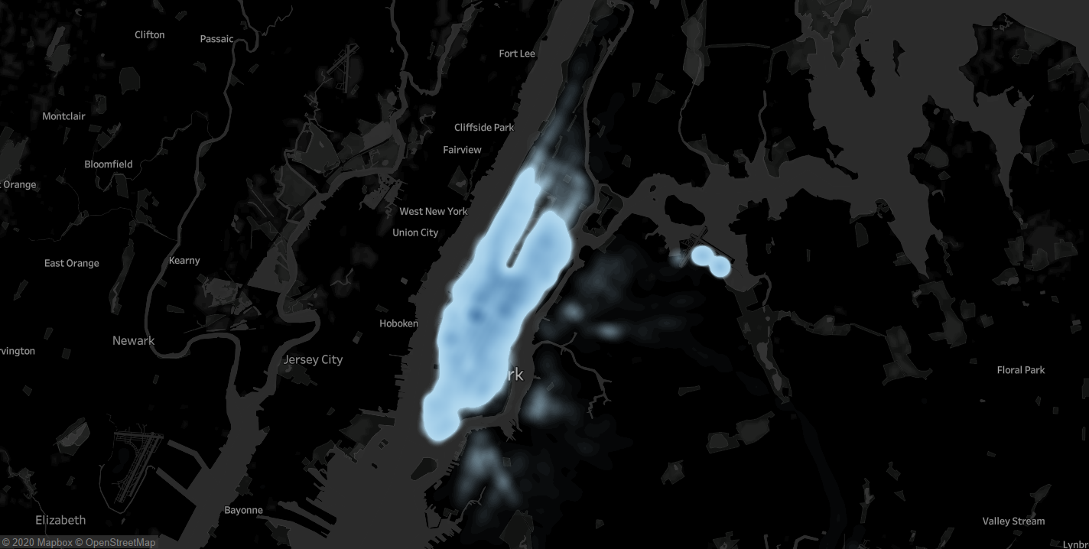
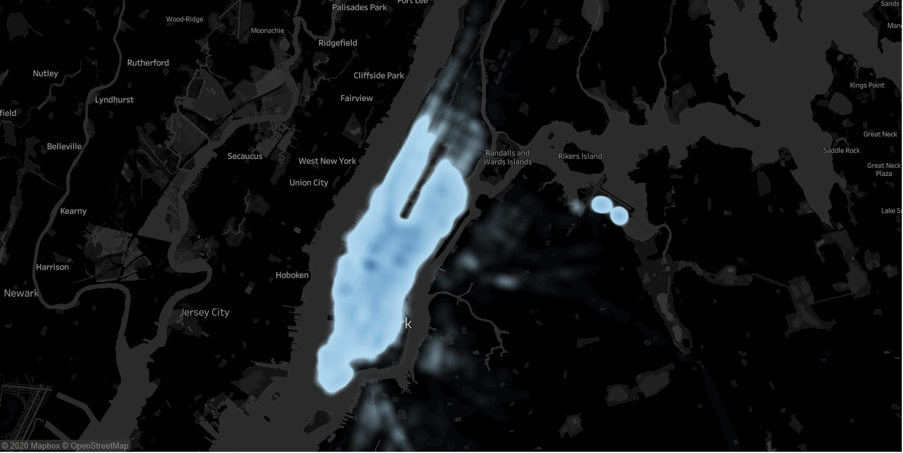
The georgraphical bounds of this specific data set is mostly focused within New York, specifically within NYC. There are ofcours,e some outliers. The screen shots below taken from Tableau Public would prove this point: A ‘Bird’s Eye View’ of traffic concentration, It is very clear that there are certain areas that are considered outliers due to their locations.

Slide 16
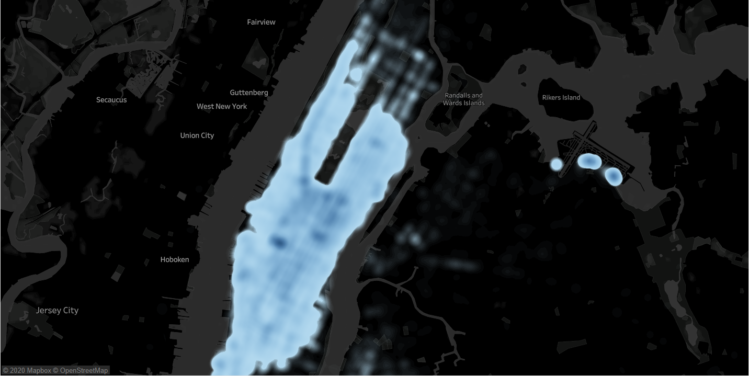
Additional images taken from Tableau Public shows both the rush hour and a clearer view of the target audience by looking at the ‘neighbourhoods’ and ‘points of interests’ within the heatmap. Image below shows the taxi usage from 6pm (1800 hrs) to 8 pm (2000 hrs)

Slide 17
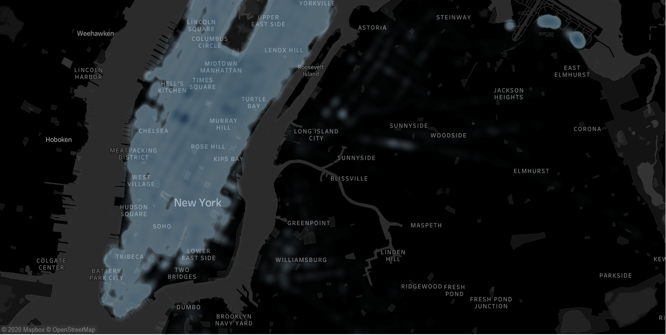
The tableau map image below shows the neighbourhoods that are of main focus within the heatmap

Slide 18
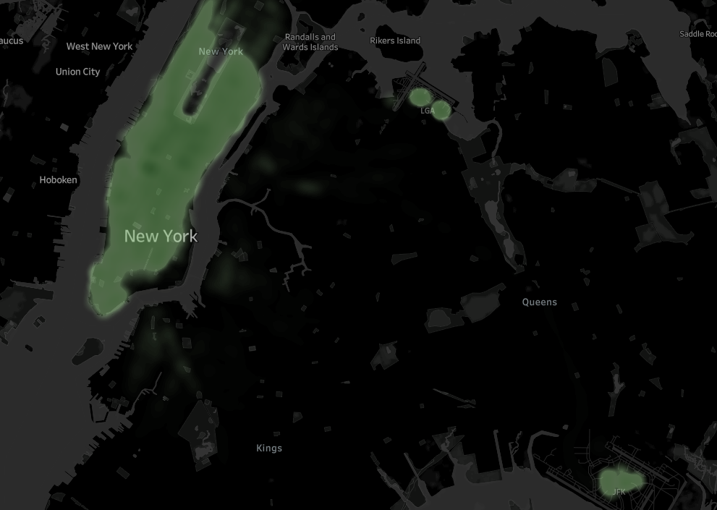
Based on the 2 heat maps, the main outliers for both Pickups and Dropoffs are : La-Guardia Airport (LGA), John F. Kennedy Airport (JFK), and some surrounding neighbourhoods within NYC. PickUps and Outliers

Slide 19
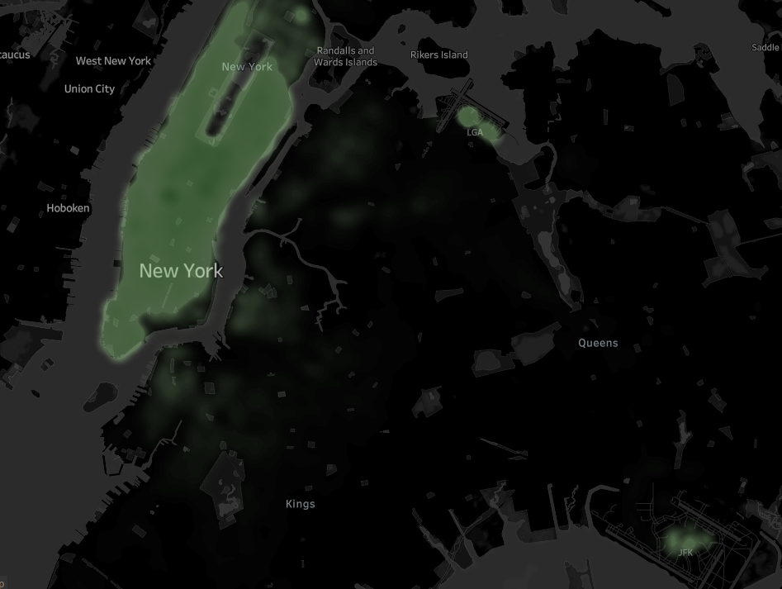
An image of Drop Offs and Outliers: As is very evident, both La-Guardia and JFK are outliers either pickups or drop offs. This is quite obvious due the nature of NYC’s activities and business operations.

Slide 20
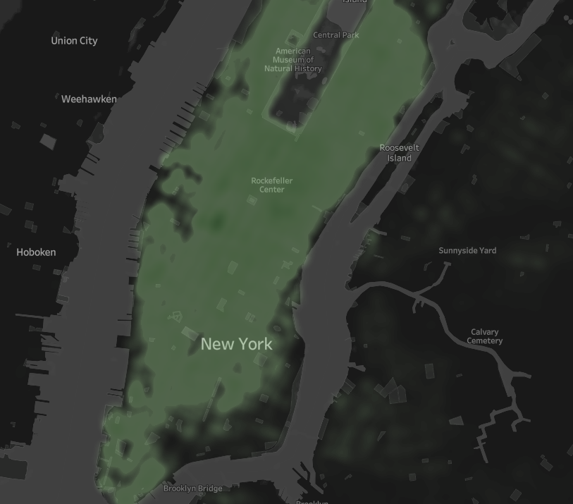
The image shows a closer look (zoomed-in) at the HIGHEST DENSITIES of both pickups and drop-offs.

Slide 21
You notice that the dataset does not contain explicit data points out-of the-box, we’ll need to enrich the dataset with relevant fields:
You notice that ride price is not included, but figure it could be derived. Based on information about New York taxi prices gleaned from the internet, create a calculated field called `price` using the `duration`, `distance`, and `passenger count` fields.
You hypothesize your target users will be those who take a relatively longer time getting to a destination that is relatively close, due to heavy traffic conditions and/or limitations to physical road infrastructure. To be able to analyze where this is happening, you will need to create a calculated field called `distance-to-duration ratio`.

Slide 22
Let’s understand the scope and distribution various dimensions within the dataset. Calculate the average, median, and the first & second standard deviation of the mean for the following measures:
duration
distance
passenger counts
duration-to-distance ratio
price

Slide 23
Answer Slide – Calculation of Values (Using Tableau)
Duration
a. Average – > 962.2 Seconds b. Median -> 662.0 Seconds c. 1st Std Dev - > 5,853 Seconds d. 2nd Std Dev - > 11,706 Seconds Distance a. Average -> 3.442 Miles b Median -> 2.095 Miles c. 1st Std -> 4.382 Miles d. 2nd Std Dev - > 8.764 Miles Passenger Counts a. Average - > 1.664 passengers OR persons b Median -> 1.000 passengers OR persons c. 1st Std -> 1.314 passengers OR persons d. 2nd Std Dev - > 2.628 passengers OR persons Duration to Distance Ratio a. Average - > 4,687 miles/min b Median -> 280.8 miles/min c. 1st Std -> 924,373 miles/min d. 2nd Std Dev - > 1,848,746 miles/min PRICE = (2.5 + (1.56*[DISTANCE]*1.61)+([DURATION]/3600)*30) a.Average = $ 6.968 b. Median = $ 5.408 c.1st Std Dev = $16.72 d. 2nd Std Dev = $33.44
** Explanation : Basic Taxi fee between $2.5 to 3.00 ; km price is $.156 , standing & waiting times is $30.00 per hour, there are 3600 secs in hour ( calculation was derived from 1 of the answers in our forums)

Slide 24
Flying cars may have to have to be a lower weight for efficiency & take-off. Or you may just decide to leverage mini-copters for your initial MVP.
Create a histogram that visualizes the number of total rides grouped by passenger counts to analyze the potential market volume of low passenger pickups (1-2 passengers).

Slide 25
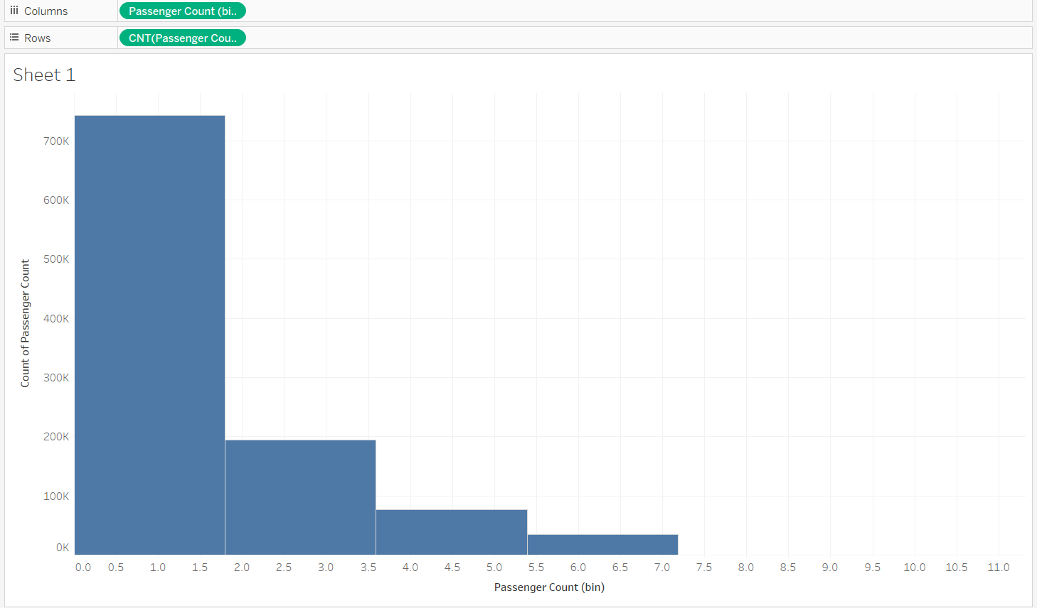
Answer Slide
A simple histogram that shows the number of rides and the potential market within NYC:

Slide 26
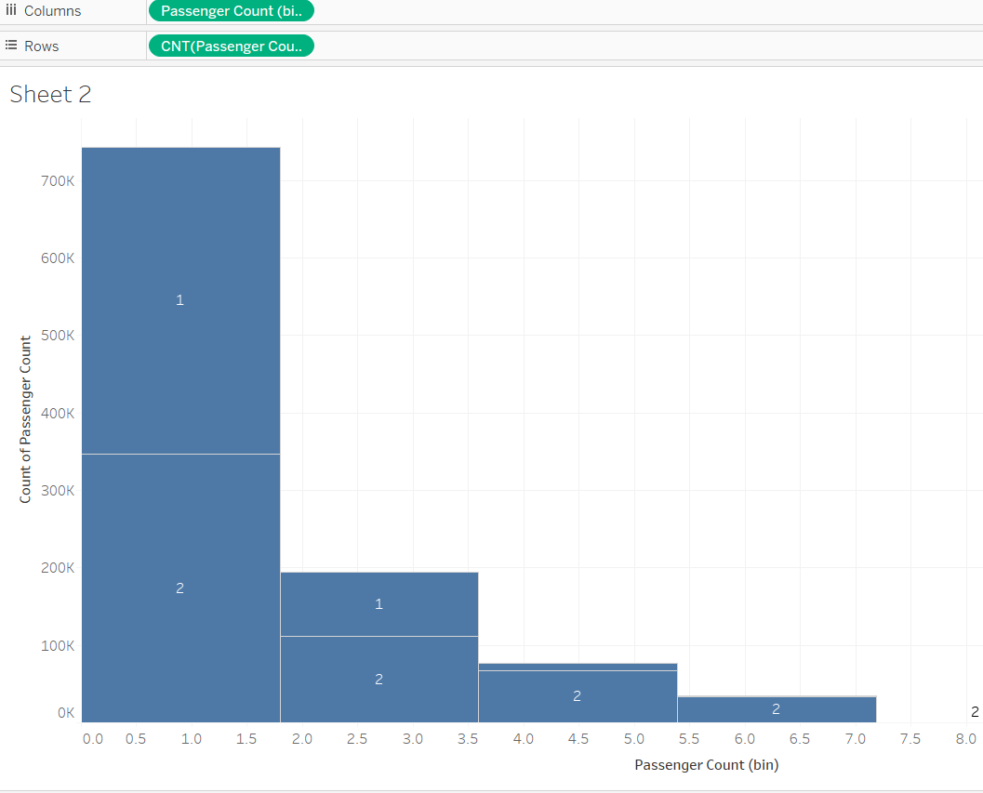
Answer Slide
A more detailed histogram with the respective Vendor IDs

Slide 27
For the initial MVP launch (& most likely GA), we have a finite amount of monetary resources to build Flyber pick-up / drop-off nodes. We’ll need to be strategic on where we’ll place them:
Which neighborhoods/zip codes tends to experience a relatively higher density of pick-ups?
Which neighborhoods/zip codes tends to experience a relatively higher density of drop-offs?
Which neighborhoods/zip codes tends to have the highest duration-to-distance ratios, based on pick-up?
Which neighborhoods/zip codes tends to have the highest duration-to-distance ratios, based on drop-off?
For any of the neighborhoods identified, are there any potential areas within the neighborhood that are optimal for flying taxi pick-up / drop-off? What makes them suitable?

Slide 28
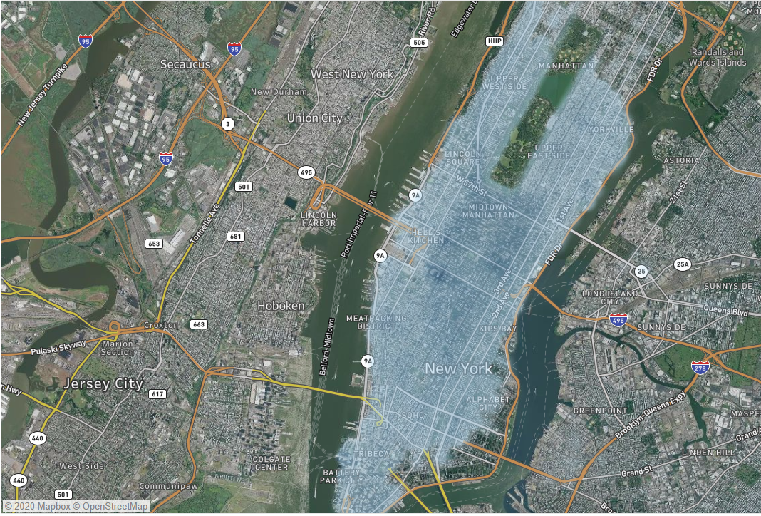
Answer Slide- High Densities of Pickups -> Satellite
Areas/localities with the highest densities of pickups: Alphabet City, SOHO, Tribeca, Kips Bay, Upper Westside, Yorkville , Hell’s Kitchen , Yorkville, Upper Eastside, Meatpacking District and some parts of Battery Park City -> SATELLITE

Slide 29
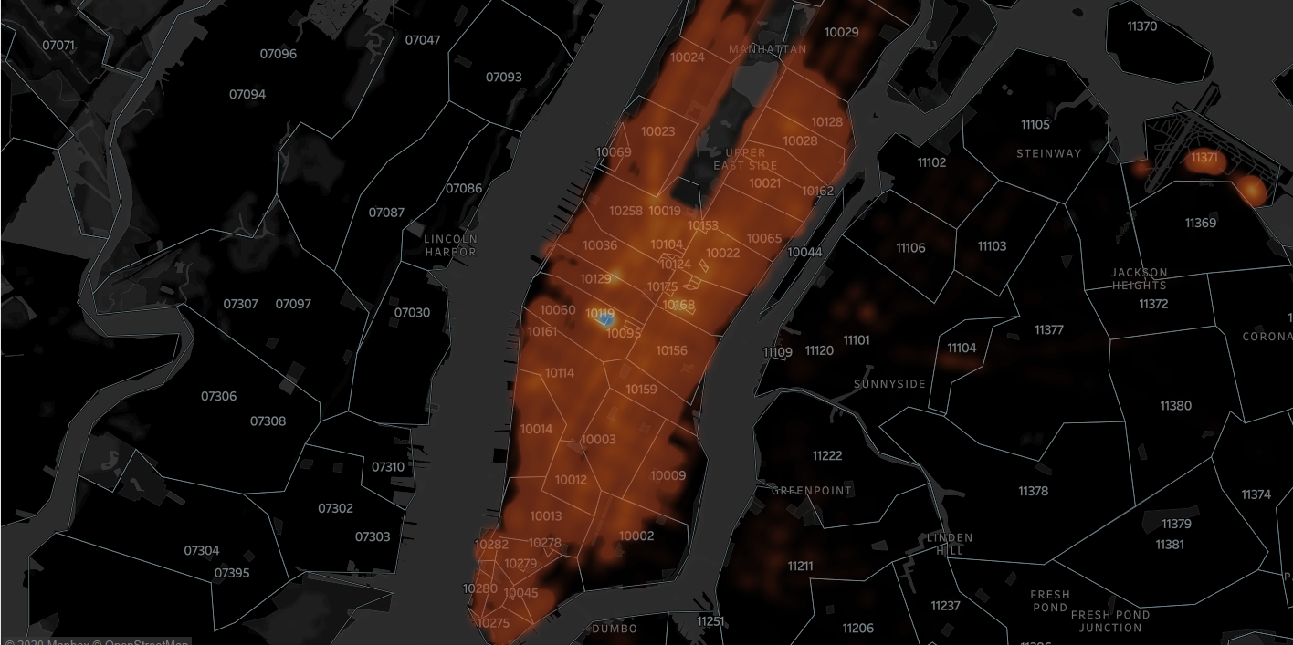
Answer Slide- High Densities of Pickups -> DarkMap(Zip)
Areas/localities with the highest densities of pickups: Alphabet City, SOHO, Tribeca, Kips Bay, Upper Westside, Yorkville , Hell’s Kitchen , Yorkville, Upper Eastside, Meatpacking District and some parts of Battery Park City -> SATELLITE

Slide 30
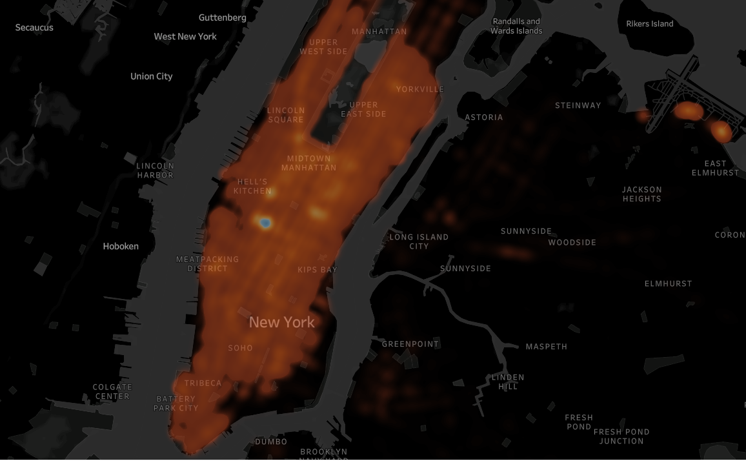
Answer Slide- High Densities of Pickups -> DarkMap(Cities)
Areas/localities with the highest densities of pickups: Alphabet City, SOHO, Tribeca, Kips Bay, Upper Westside, Yorkville , Hell’s Kitchen , Yorkville, Upper Eastside, Meatpacking District and some parts of Battery Park City -> SATELLITE

Slide 31
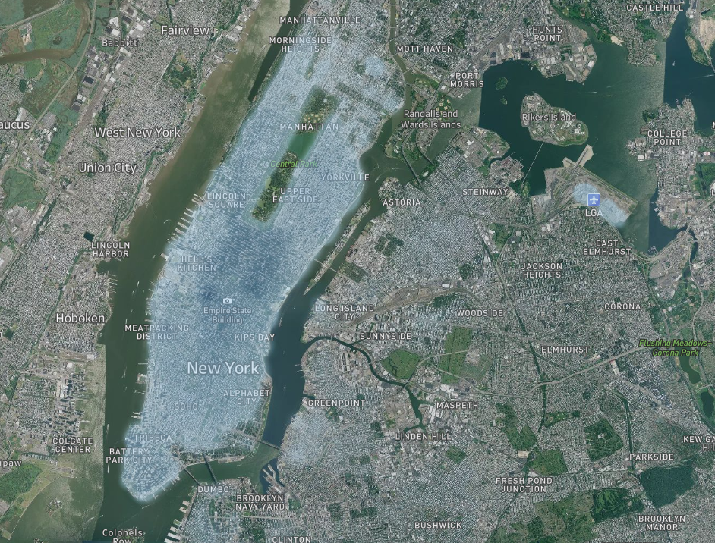
Answer Slide – High Densities of Dropoffs -> Satellite
Areas/ localities with high % of drop-offs: (majority are the same as the pickups) SOHO, Hell’s Kitchen, Tribeca, Manhattan , half of Meatpacking district, Empire State area, La-Guardia Airport, KIPS Bay, Alphabet City, DUMBO, Lincoln Square, Morningside Heights

Slide 32
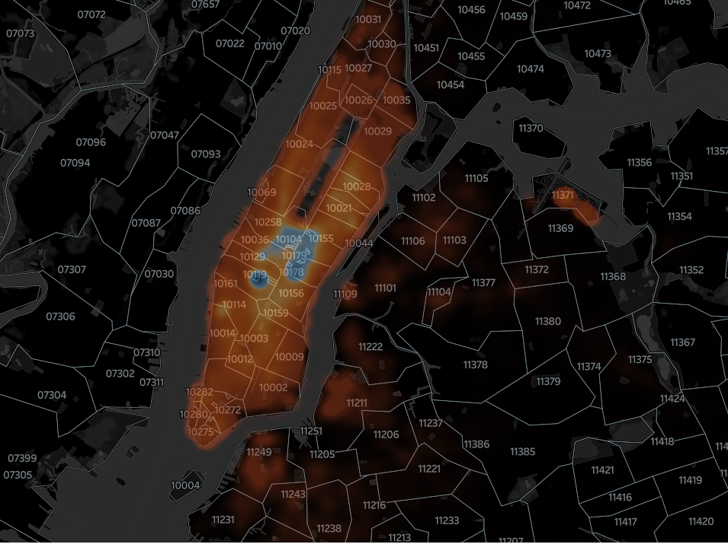
Answer Slide – High Densities of Dropoffs -> DarkMap(Zip)
Areas/ localities with high % of drop-offs: (majority are the same as the pickups) SOHO, Hell’s Kitchen, Tribeca, Manhattan , half of Meatpacking district, Empire State area, La-Guardia Airport, KIPS Bay, Alphabet City, DUMBO, Lincoln Square, Morningside Heights

Slide 33
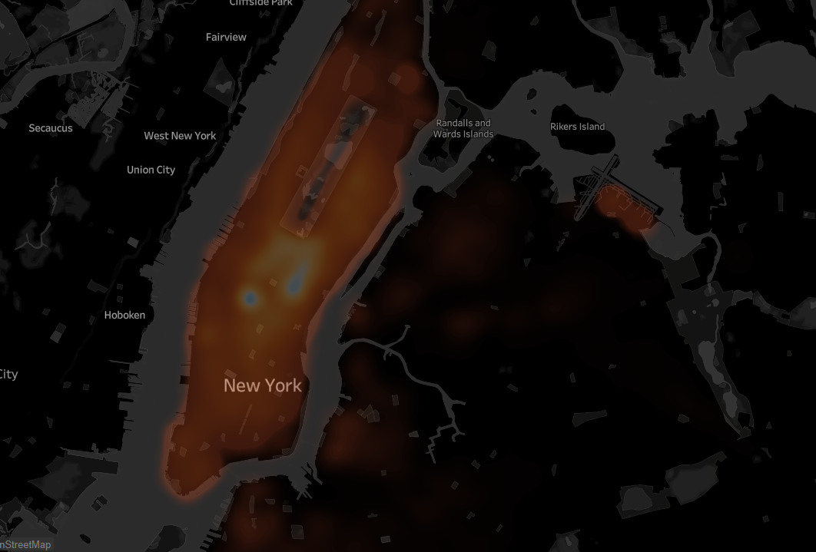
Answer Slide – High Densities of Dropoffs -> DarkMap(Cities)
Areas/ localities with high % of drop-offs: (majority are the same as the pickups) SOHO, Hell’s Kitchen, Tribeca, Manhattan , half of Meatpacking district, Empire State area, La-Guardia Airport, KIPS Bay, Alphabet City, DUMBO, Lincoln Square, Morningside Heights

Slide 34
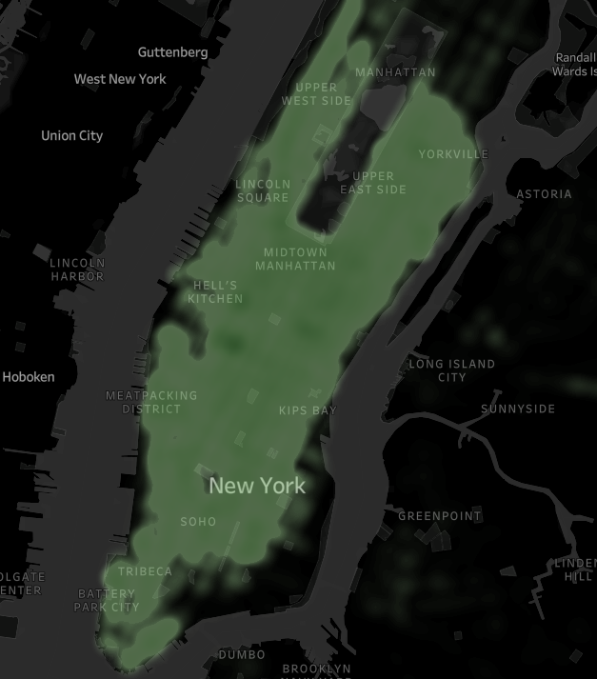
Answer Slide – highest distance-to-duration ratios based on pickups
From this image, we can see that the highest densities of distance to duration pickups are: Hell’s kitchen, Upper East Side, Yorkville, Midtown Manhattan, Lincoln Square, Meatpacking District, Kip’s Bay, SOHO, Tribeca and Battery Park City . Also included are LGA and JFK Airports

Slide 35
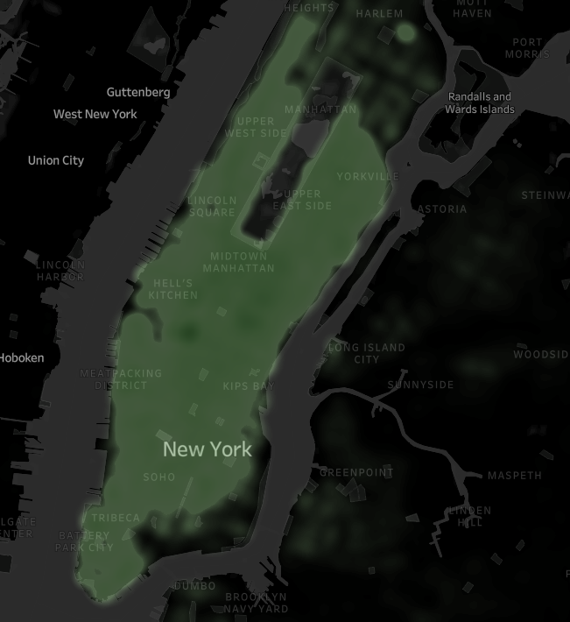
Answer Slide – Highest Distance-to-Duration Ratio based on dropoffs
From this image, we can see that the highest densities of distance to duration dropoffs are: Hell’s kitchen, Upper East Side, Yorkville, Midtown Manhattan, Lincoln Square, Meatpacking District, Kip’s Bay, SOHO, Tribeca and Battery Park City . Also included are LGA and JFK Airports

Slide 36
It may not make operational sense to have the service running 24/7, for now.
What times throughout the day experience relatively higher volumes of ride pick-ups?
What days throughout the week experience relatively higher volumes of ride pick-ups?
Pinpoint any periods throughout the year that experience trend fluctuation or seasonality around ride pick-up volumes. This will help us in our post-launch analyses to determine if any spikes or dips were influenced by seasonality or through actual feature adoption/regression.

Slide 37
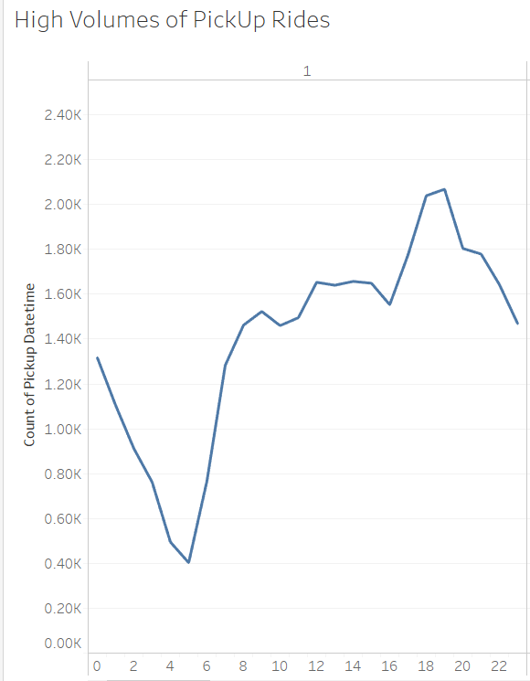
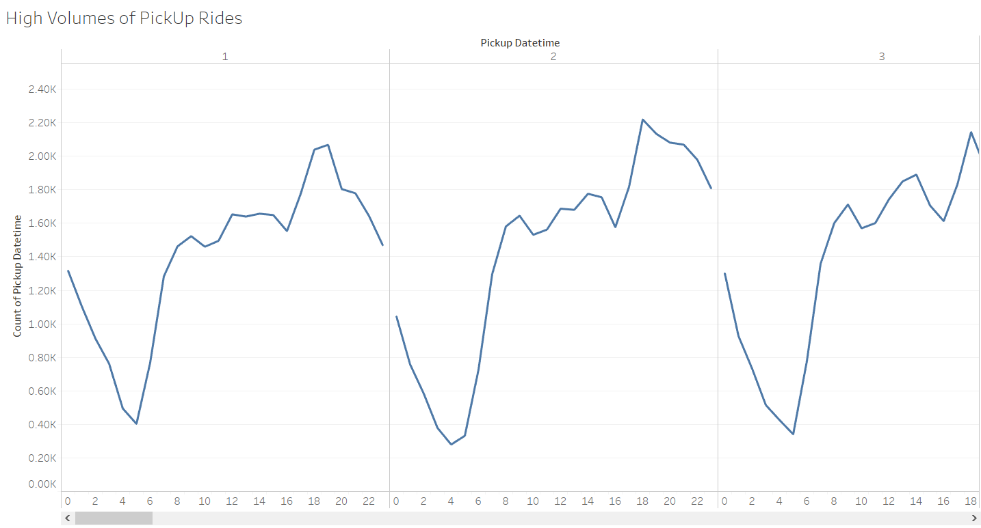
Answer Slide – Operational Value for 24/7 Services - > Hours Via Days
What times throughout the day experience relatively higher volumes of ride pick-ups? The line graph below shows the times throughout the day where there are high pickup volumes: 1800h to 2000h ( 6pm to 8pm)

Slide 38
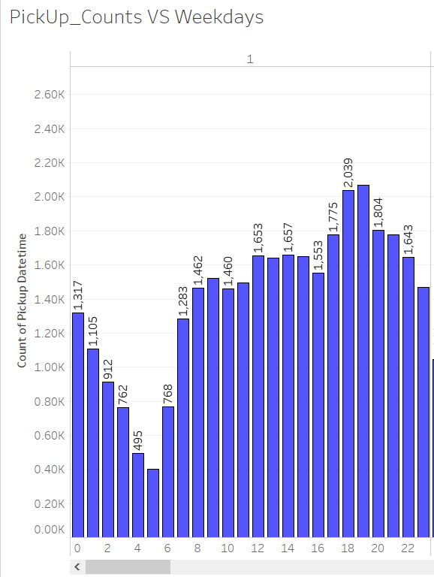
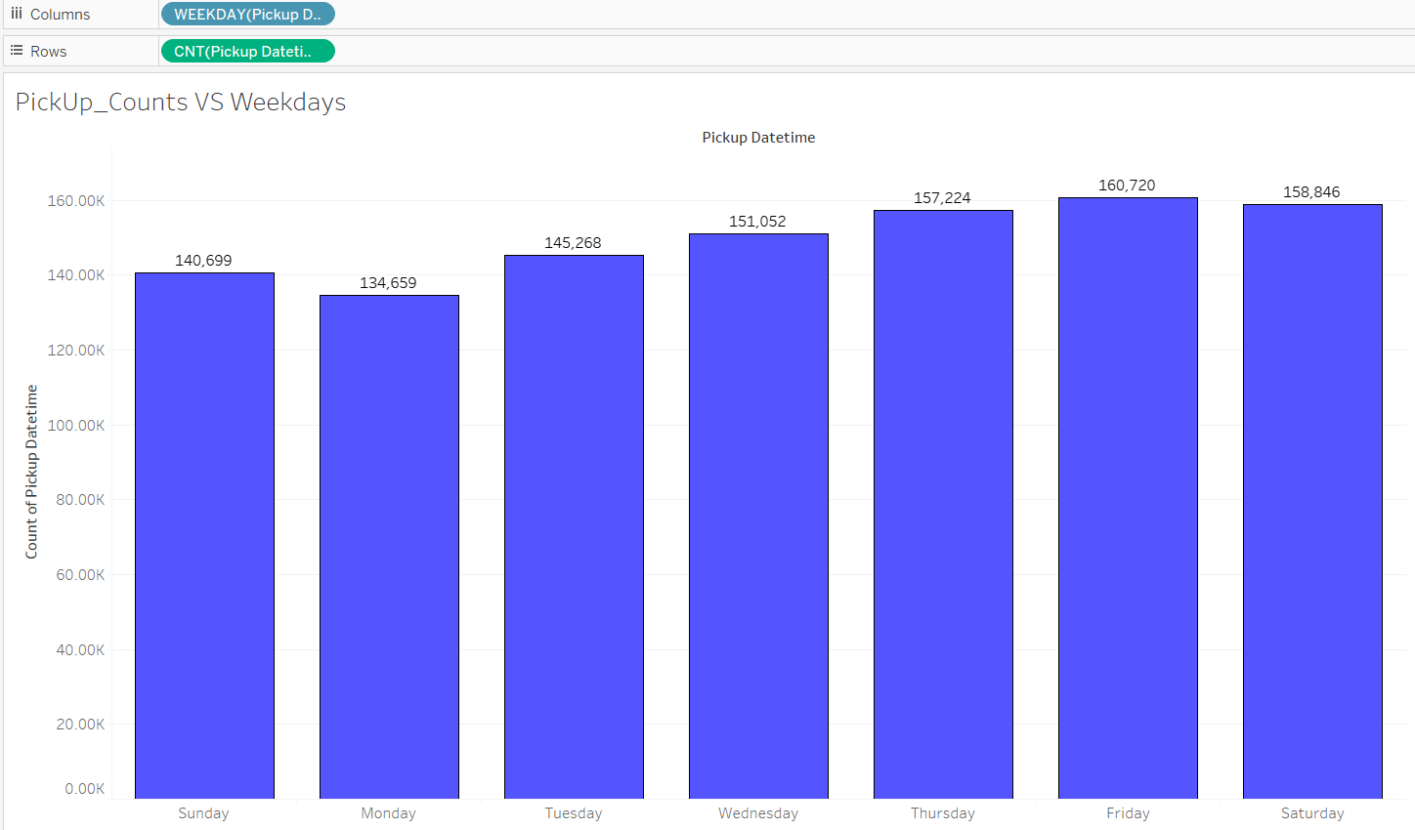
Answer Slide – Operational Value for 24/7 Services -> Days Via Week
What days throughout the week experience relatively higher volumes of ride pick-ups?The bar graph below shows the days throughout the week where there are high pickup volumes: (starting on a Sunday)

Slide 39
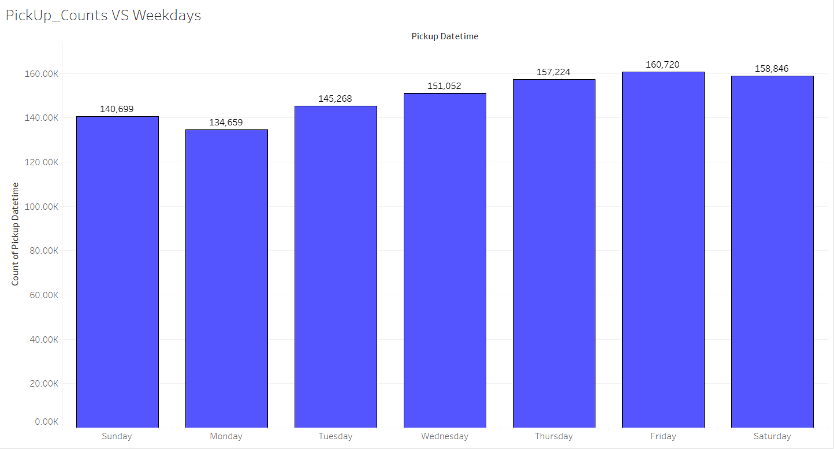
Operational Value for 24/7 Services -> Days in week (MORE DETAILED VERSION)
The bar graph below shows the days throughout the week where there are high pickup volumes: (starting on a Sunday). This shows that Friday had the highest pickups weekly with 160.72k . Immediately followed by Saturday with 158.85k

Slide 40
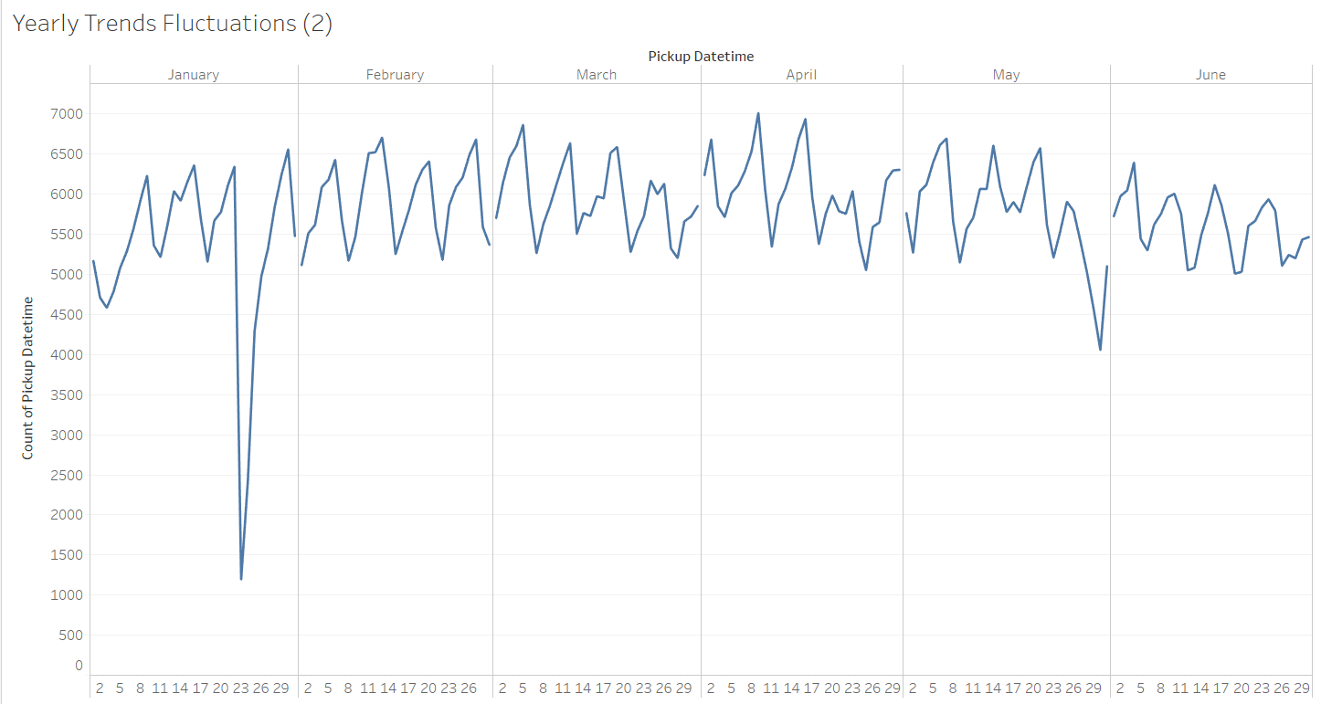
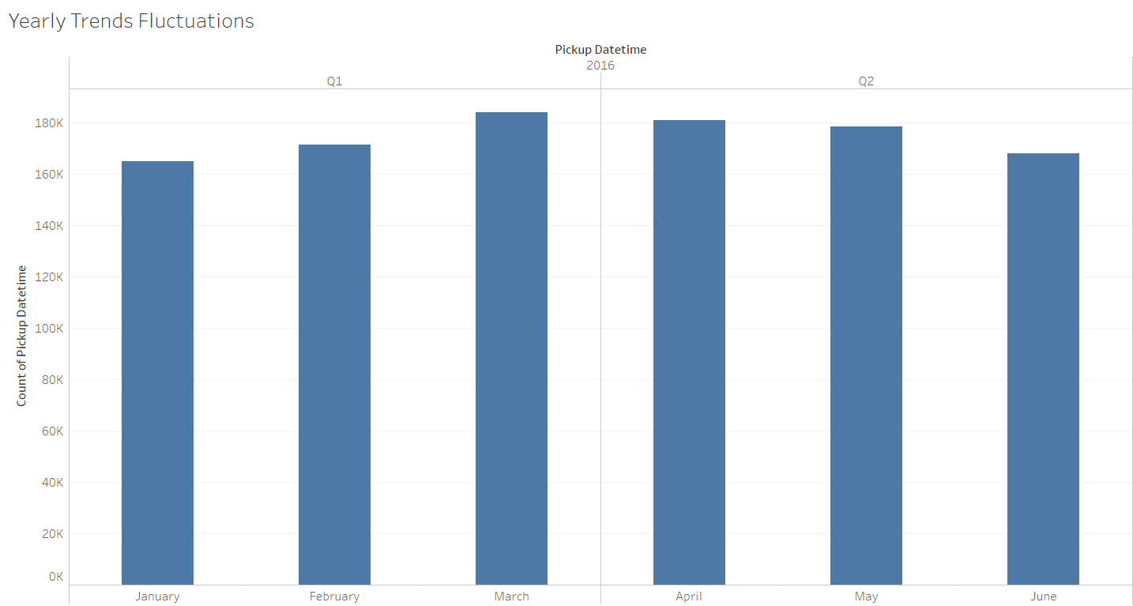
Answer Slide – Operational Value for 24/7 Services -> Trend Fluctuation
Analysis of any trend fluctuations throughout the year regarding ride pickup volumes. There appears to be a HUGE DIVE (DECREASE) in rides during 3rd week of January. Also a slight dive/decrease during the last week of May.

Slide 41
You and the user research team ran a quantitative survey on existing taxi and/or rideshare users in New York City to determine sentiment around potentially using a flying taxi service.
Dive into the survey results dataset in order to extract insights from explicit feedback.
Upload this dataset into Tableau Online or a SQL database (the classroom contains a workspace with the data for you as well).

Slide 42
Ensure the fields are parsed correctly, field headers are included in the first row of the CSV.
Question schema:
Q1 - What is your email?
Q2 - What gender do you identify as?
Q3 - What is your age?
Q4 - What is your annual income? (income bands)
Q5 - What neighborhood do you reside in?
Q6 - Do you currently use taxis? (Y/N)
Q7 - Do you currently use ridesharing services? (Y/N)
Q8 - Would you use a flying taxi service, if such a concept existed? (Y/N)
Q9 - If yes to Q8, how much would you be willing to pay per mile for such a service? (USD)
Q10 - If no to Q8, what is the reason?

Slide 43
To inform our future product marketing efforts, we’ll want to extract the following:
Is there an inclination of better Flyber adoption based on gender, age, income level, or neighborhood of residence?
What is the distribution of potential price per mile based on gender, age, income level, and neighborhood of residence?
What is the different personas/segments of negative sentiment towards not using a flying taxi car service?

Slide 44
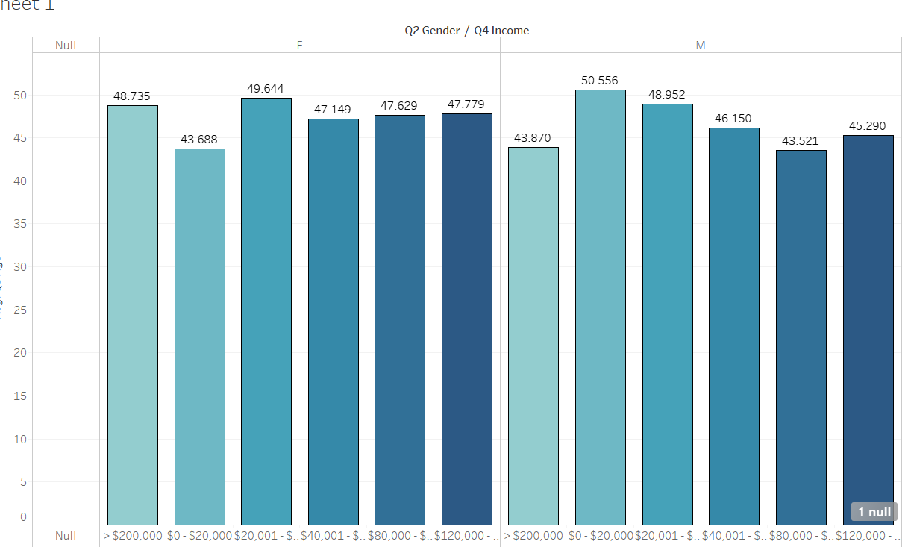
Answer Slide –User_Research Data
A simple visualization regarding the breakdown of target audience . Metrics used are: Gender, Age & Income

Slide 45
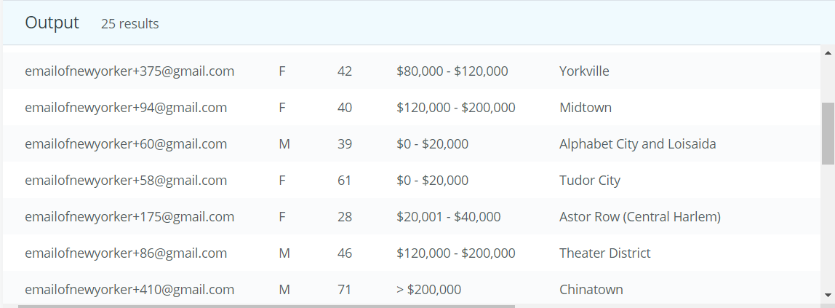
Answer Slide- User Research Data
A simple query would reveal random selection of data within the User research data set: select * from user_research LIMIT 25;

Slide 46
Answer Slide- User Research Data – Demographics Analysis via SQL
Query regarding genders : select COUNT(*) from user_research WHERE q2 = ‘M’; Result = 192 Male participants select COUNT(*) from user_research WHERE q2 = 'F’; Result = 307 Female participants Query determining whether they use ride-sharing services : select * from user_research where q7 = 'Y’; result = 295 from both genders and all age levels use ride-sharing services, 205 does not use ride-sharing services

Slide 47
Answer Slide- User Research Data – Demographics Analysis via SQL
select * from user_research where q3 < 30; Result = 109 participants below 30 years old select * from user_research where q3 >= 30; Result = 390 participants aged 30 and above select * from user_research where q4 > '100000'; result = 474 participants have yearly incomes higher than 100k ( meaning 25 participants earn less than 100k) select * from user_research where q6 = 'Y’; result = 406 uses taxis, 93 doesn’t use it.

Slide 48
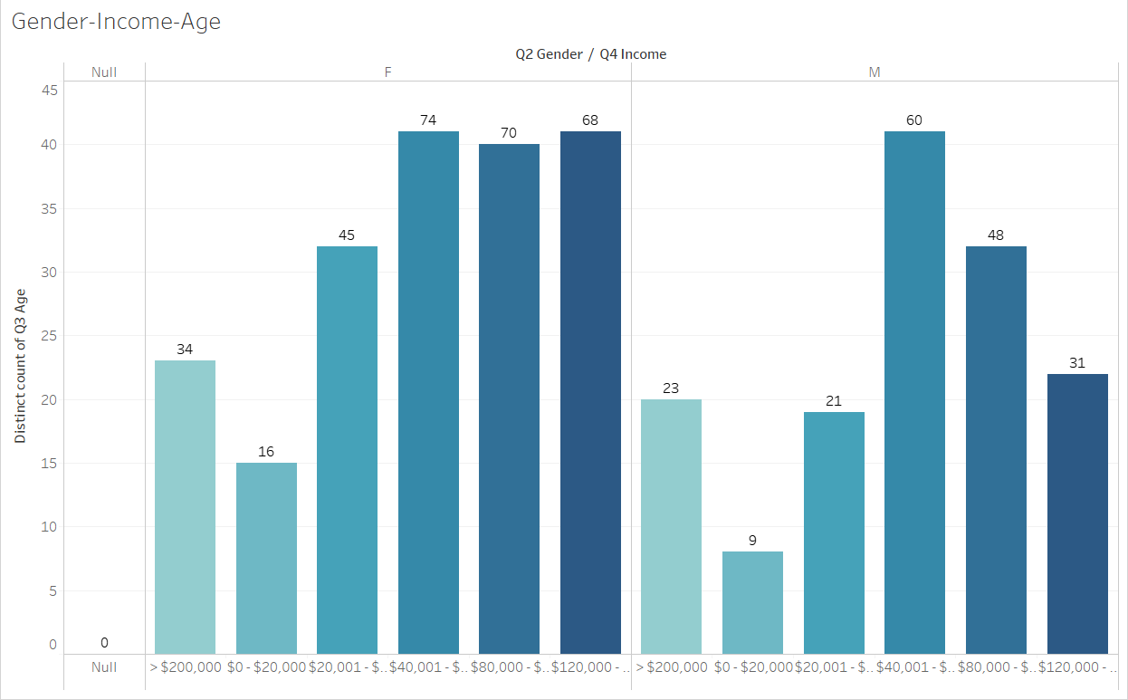
Answer Slide- Graph based on Gender, Income & Age
The graph shows that out of 307 Female passengers, 212 were earning between 40k to 120k+ annually. Out of 192 Male passengers, 139 were earning between 40k to 120k + annually.

Slide 49
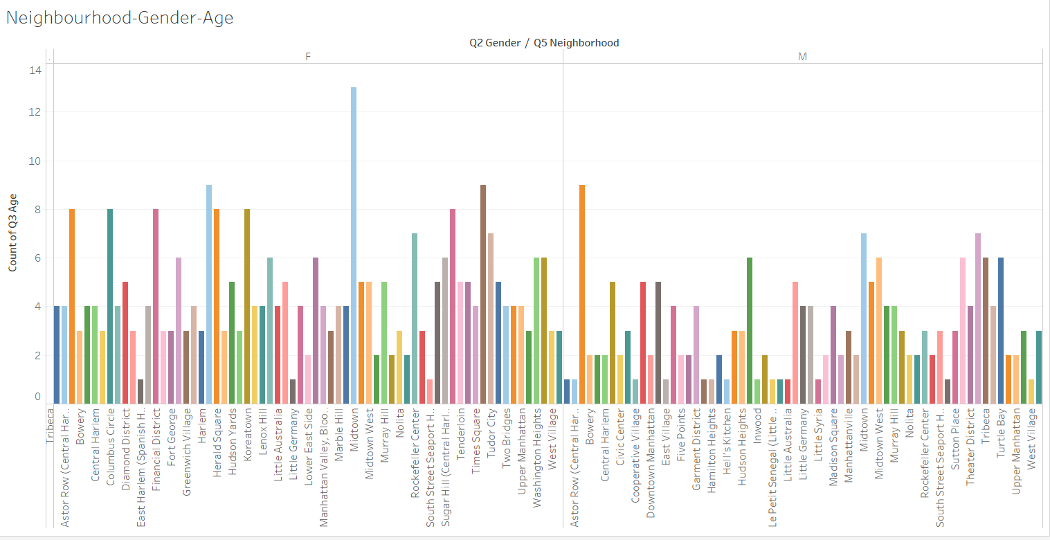
Answer Slide- User Research Data- Neighbourhoods
The dataviz below gives another overview of the diversity in the neighbourhoods where respondents reside in. The highest lives in Midtown Manhattan with 13. Then at second are: Tribeca, Battery Park 7 Hell’s Kitchen with 9 respondents.

Slide 50
Answer Slide- Analysis and Findings Regarding Demographics (PART 1)
Based on the over-all findings , that could be proven using the 2 bar graphs and the SQL scripts, here are the results : 1. For both genders, the average yearly income is within the 80k range. This means that the target audience is on the higher bracket. 2. 294 over-all uses ride sharing services, 204 doesn’t. This means that more than 50% are willing to spend money on such services. 3. 406 uses taxis and 93 doesn’t use. 81% of the respondents use taxis. 4. A total of 204 never used ride-sharing services 5. 99 respondents said they will NEVER use a flying taxi service , while a whopping 400 said YES! 6. Among the respondents who said yes to flying taxi services, the maximum amount willing to be paid was $46 per ride and the minimum was $5 7. Those who said ‘NO’ they will never use flying taxis, most have mentioned that it was related to ‘safety & security’ and also a large group said ‘it was too expensive’.

Slide 51
Additional Analysis and Findings Regarding Demographics(PART 2)
Based on the several key findings that were observed by using the User_Research DataSet, it could be concluded that: 8. The target audience comes from a very diverse locations in NYC, but a great majority are earning an average of 80k yearly. This means that they are on the upper bracket of employees. 9. More than 50% have used ride sharing services before. Although not by a huge margin, this is still an indication that the target market is somewhat ready for our product. 10. 81% have used taxis before. 11. More than 75% are willing to use a flying taxi service once it is being offered. 157 Males said they were and 243 Females. 12. The 99 respondents who said NO to flying taxis came from a wide variety of neighbourhoods. 13. The same 99 respondents who said NO to flying taxis have a very diverse range of yearly income. Some are eraning 40k yearly while other are on the 120k and a handful were earning 200k yearly. CONCLUSION: There is NO SPECIFIC target audience where Flying Taxis are veering towards. The genders vary almost equally, the place of residence are also widely distributed, the age group is also very diverse. The same thing applies to their annual income. The ONLY things that really resonates regarding the 99 respondents who said NO were: they were deeply concerned with the safety & security of flying taxis. A second reason is they have an image/ notion that it would be very expensive.

Slide 52
BONUS SECTION: TABLEAU PUBLIC LINKS: My Main Tableau Public Link: https://public.tableau.com/profile/frederick.zoreta.first#!/ Taxi Rides Version 1(Yearly Trends & Fluctuations): https://public.tableau.com/profile/frederick.zoreta.first#!/vizhome/Udacity_Flyber_Project1/YearlyTrendsFluctuations2 Taxi Rides Version2 (Highest Drop Offs): https://public.tableau.com/profile/frederick.zoreta.first#!/vizhome/Udacity_FLYBER_Version2/Highest_Dropoffs-DarkMap User Researc (Neighbourhoods-Gender=Age): https://public.tableau.com/profile/frederick.zoreta.first#!/vizhome/Udacity_User-Research/Neighbourhood-Gender-Age

Slide 53
Hooray! End of Section 1.

Slide 54
You will complete Section 2 at the end of this course.
Please submit this file for review for Section 1.

Slide 55
Section 2: Proposal Synthesis

Slide 56
Identify a product objective for Flyber's launch. Your product objective will guide your KPIs, so identify what Flyber should optimize for. Your objective should be centered around one the following focus areas:
User Acquisition
User Engagement
User Retention
Profitability
Explain your reasoning. Include both why you feel your focus area is more relevant than the others for Flyber at this time of the product development cycle.

Slide 57
Answer Slide – Product Objectives to Guide KPIs(Part 1)
* User Acquisition – a. Brand Awareness & Brand Identity -> it has been a time-tested aspect of marketing & any form of product engineering that 1 of the effective ways to attract or acquire more audience is to have a solid & reputable ‘BRANDING’ b. Customer Experience or CX -> Since Flyber would be an actual, physical experience on top of how our target market would use an app or website, it is highly imperative that passengers would have a wonderful experience from step 1 which is scheduling via app until the time they exit Flyber’s flying taxi. I can personally vouch for this by having more than 200+ Uber rides. 97.8% of my trips so far are really amazing! c. User Experience or UX -> This would be extremely similar to CX but is only focused on the passenger’s ‘user interaction journey’. This means that a user must have a good experience from using our app pr website in booking a flying taxi ride.
* User Engagement – a. Product Knowledge -> This would apply more to the technical support & customer service agents who would be dealing with issues and specific complaints. Such issues would be: app or website not functioning, billing issues , driver complaints, etc. The specific ‘knowledge’ would be focused on company policies , navigating the app/site, etc b. UX & CX also highly applies to User Engagement. For users of any product or service to be fully engaged, they should have an excellent ‘customer journey’.

Slide 58
Answer Slide – Product Objectives to Guide KPIs(Part 2) -> Focus on User_Acquisition
* User Acquisition – Brand Awareness & Brand Identity -> it has been a time-tested aspect of marketing & any form of product engineering that 1 of the effective ways to attract or acquire more audience is to have a solid & reputable ‘BRANDING’ ** I would like to have a more in depth look into User_Acquisition. Why? The very core center of user acquisition is on having or acquiring new users ( and even maintaining the current ones we have). But as a new business, Flyber’s main focal objective is BRAND IDENTITY. Similar to what Uber, AirBnB, Starbucks, Tableau, TESLA ,Nike & ofcourse; UDACITY has! We must have that UNIQUE & AMAZING image that automatically makes users and potential users get easily attracted. Flyber would be doing this by having highly intense yet focused and systematically calculated marketing efforts. This would be a great way to acquire new customers. Since we are new, we have to capture a certain share of the market. And even if market acquisition is our main concern, we also have to highly consider sustainability. We can’t afford to just have new customers and let them slip by after 1 or 2 rides. We want them to be with us for as long as they need a ride. With this specific campaign, I would strongly suggest that we use our best UX Researcher, UX Designers and if possible; to hire a ‘Human Factors’ consultant to work with our marketing team. I would also highly suggest to have atleast 1 or 2 drivers and mechanics to be part of this team. This would give the campaign a VERY REALISTIC outllook.

Slide 59
Answer Slide – Product Objectives to Guide KPIs(Part 2) -> Focus on User_Acquisition
* User Acquisition – Brand Awareness & Brand Identity -> it has been a time-tested aspect of marketing & any form of product engineering that 1 of the effective ways to attract or acquire more audience is to have a solid & reputable ‘BRANDING’ ** How will this Key Performance Indicator (KPI) be measured? There are 2 ways for us to track this specific metric. 1. Once a potential user signs in for an account with Flyber; even without scheduling a ride yet, that is considered a ‘conversion’. Whether the user creates an account for the app or the website, it is considered as the same conversion. What is my reason for having this as a conversion? Flyber is an ultra brand new service & technology. Realistically, we can not expect a new user/client to schedule a ride asap. Especially if the service is a flying car. Eventually once the business, or entire industry has already been established, then a conversion for ‘user_acquisition’ would be someone who has a minimum 1 ride which has a recorded ‘drop_off’ point. 2. Any member of the target audience that signs up for our electronic newsletters , those who are active on our social media accounts ( especially those who engage a LOT) are considered an ‘acquisition’. My rationale for this would be exactly the same as #1. Being a new industry ; which some new –comers may consider as a safety hazard; this would be a good start. As previosuly mentioned, as the market and industry matures, the tracking of this KPI would be changed to a user who has at least 1 finished ride. We will also eventually have KPIs for repeat customers, customer retention and referrals.

Slide 60
Formulate 3-5 Key Performance Indicators (KPIs), to measure if the product is heading towards the right direction based on your objective

Slide 61
Answer Slide – Formulation of KPIs(Determining Flyber’s Success during MVP)
3 Key Performance Indicators – to be utilized our initial success 1. The number of users/passengers during the following time ranges: first 3 months, first 6 months , first 9 months and the 12th month. A quick hypothesis based on the data I’ve gathered, plus my viewpoints and experience in visting NYC, a targeted 10k passengers is expected to be reached during month 9. 2. The number of referrals from passengers is expected within the first 6 to 8 months. The hypothesis I have is that there will be a surge in referrals after the 6th month. A probale average of 3 to 4 referrals from 1 passenger is expected. Normally it does take time for a new technology service to pickup.
3. The amount of flying taxi drivers would increase after the 6th month. I am projecting there will be at least 500 drivers during the first 3 months. Afterwards , that could increase to atleast 1k by the time we turn 6 months.

Slide 62
Create hypotheses around what thresholds your KPIs would need to hit in order to determine success

Slide 63
Answer Slide – Hypothesis around the 3 KPIs
1. The number of users/passengers during the following time ranges: first 3 months, first 6 months , first 9 months and the 12th month. A quick hypothesis based on the data I’ve gathered, plus my viewpoints and experience in visting NYC, a targeted 10k passengers is expected to be reached during month 9. 2. The number of referrals from passengers is expected within the first 6 to 8 months. The hypothesis I have is that there will be a surge in referrals after the 6th month. A probale average of 3 to 4 referrals from 1 passenger is expected. Normally it does take time for a new technology service to pickup. 3. The amount of flying taxi drivers would increase after the 6th month. I am projecting there will be at least 500 drivers during the first 3 months. Afterwards , that could increase to atleast 1k by the time we turn 6 months.

Slide 64
As the product manager, you make decisions based on the insights you extract, we’ll need to know the feature set we’ll include in the MVP to measure viability, while keeping operational expenditure under control:
What times/days of operation should the service run for?
How many pick-up / drop-off nodes should we have?
Where should the nodes be located?
Should we initially use copters or homegrown hardware?
Should the pricing be fixed or dynamic? At what rates?

Slide 65
Answer Slide – Results were based on the data from the Midterm section
1. What times/days of operation should the service run for? **Based on the initial spatial & numeric data being gathered, there is a very strong demand during Fridays and Saturdays. There is a huge demand from 6pm to 8pm daily, but we shouldn’t limit it to such hours. **Pls see table on the next slide

Slide 66
Continuation: What times and days should we be running services?
What times throughout the day experience relatively higher volumes of ride pick-ups? The line graph below shows the times throughout the day where there are high pickup volumes: 1800h to 2000h ( 6pm to 8pm)

Slide 67
How many pick-up / drop-off nodes should we have? This could be answered by the previous data gathered (see below) Since Midtown Manhattan is at the centre that could be 1 pickup node, plus the 2 airports , manhattan and tribeca : THAT’S A TOTAL of 5 Pickup Nodes ( 1.Mid manhattan 2. JFK 3. LaGuardia 4. Manahattan 5. Tribeca – highest distance-to-duration ratios based on pickups
From this image, we can see that the highest densities of distance to duration pickups are: Hell’s kitchen, Upper East Side, Yorkville, Midtown Manhattan, Lincoln Square, Meatpacking District, Kip’s Bay, SOHO, Tribeca and Battery Park City . Also included are LGA and JFK Airports

Slide 68
Should we initially use copters or homegrown hardware? I would suggest further research by experts on mechanical, electrical and automotive experts.
If I am to hypothesize on this, I would say that it could be a combination of both. Normally, new technologies and services like ours would not have an exact data on flying taxi services.
Should the pricing be fixed or dynamic? At what rates?
PRICE = (2.5 + (1.56*[DISTANCE]*1.61)+([DURATION]/3600)*30) a.Average = $ 6.968 b. Median = $ 5.408 c.1st Std Dev = $16.72 d. 2nd Std Dev = $33.44
** Explanation : Basic Taxi fee between $2.5 to 3.00 ; km price is $.156 , standing & waiting times is $30.00 per hour, there are 3600 secs in hour ( calculation was derived from 1 of the answers in our forums)
**based on the above calculation which was derived from midterms, I would highly suggest to start at fixed price. This is somewhat similar to what Uber did. We have to make sure that the target audience is highly familiar with our services & pricing at first. I’d say let’s start with:
How much is the taxi fare in New York City? The basic fee is $2.50, the kilometer price is $1.56. For standing and waiting time, $30.00 is charged per hour.

Slide 69
Determine the MVP sample size & time period allotted estimated to come to a conclusion on your hypotheses.

Slide 70
Answer Slide –MVP Alloted Sample Size
The entire sample size definitely presented a good data set that gave enough insights. All the insights which ranges from numerical to spatial, from spreadsheets to qualitative data use din user research, the sample size for NYC was enough. I would also give a resounding YES to the period allotted. Although a much longer time would have been preferred, based on the quantitative & qualitative data gathered, it was enough of a time period. Based on our data, both taxi data set and user research data set proves that we have a well presented data set in order to study the target audience.
YES!

Slide 71
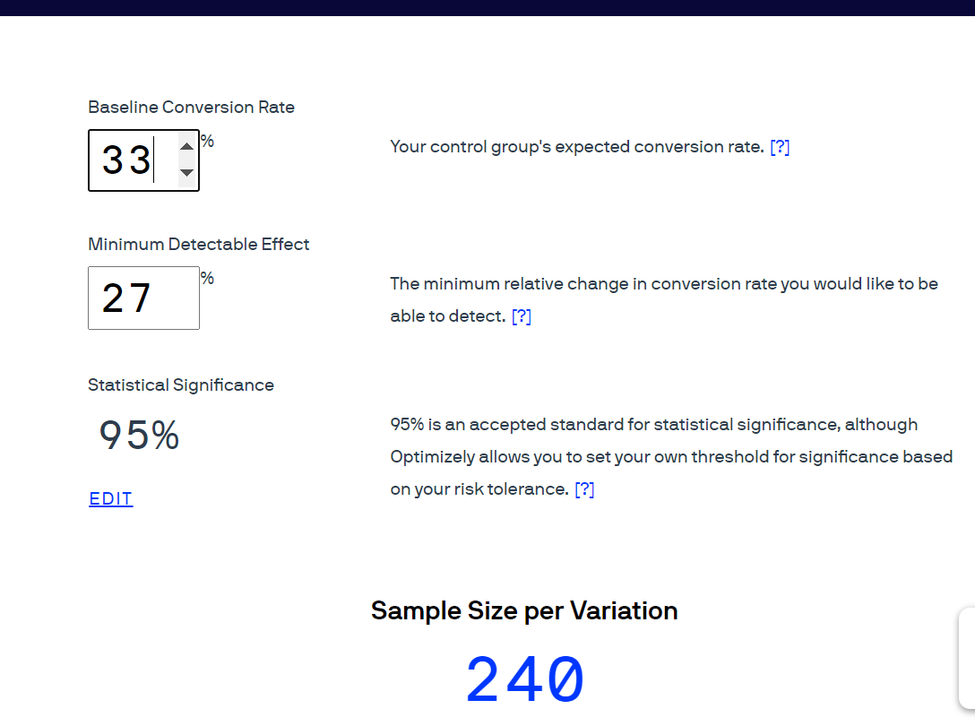
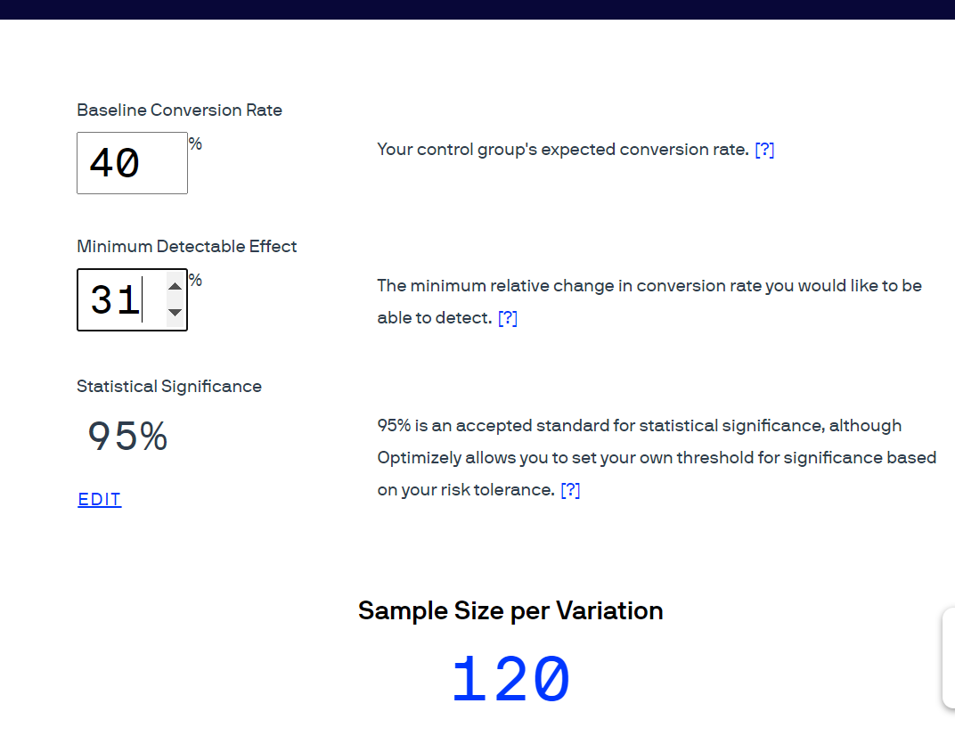
Answer Slide – Sample Size Analyzed By Optimizely
The above data shows 2 possibilities within our sample size. The 1st has a baseline conversion rate of 33% , having 26 % of probable detectable effect. Our sample size here is 240. The 2nd box shows a 40% conversion rate with a 31% minimum detectable effect. The sample size here is 120. **The estimated time period for this entire experiment would be 5 months. That would be 150+ days.

Slide 72
Create an instrumentation plan for the events you need collected and logged, in order to be able to physically measure your KPIs.

Slide 73
Answer Slide – Basic Instrumentation Plan-> Events & Properties that triggers a metric or KPI
1. Completed_Ride - > activated when user schedules for a ride either via app or website ( we highly prefer using the app). This event gets fired/triggered when a Flyber ride ends. Specific properties for this are: ride_id, ride_end_timestamp, ride_start_timestamp,etc 2. Cancelled_Ride - > A user has the option to cancel without paying if cancellation is within 1 minute. If it exceeds 1 minute, the user would eventually be charged on a ‘waiting basis’. Once the taxi arrives, after 2 minutes, the user is charged on a regular fare; whether he/she is onboard or not (similar to Uber). ** Even if a ride gets cancelled after the 1 minute mark (where charging occurs), the user still has the option to cancel. That is counted as ‘Cancelled_Ride’. 3. Refunded_Payment - > Occurs in certain scenarios such as: a. user finishes a ride but gave a very low rating ( a combination of both quantitative & qualitative ). This states that a user/rider had a very bad experience. There will be a button on the app after a ride has finished. 4. Partial_Refund_Payment - >Another scenario is when an unforeseeable incident occurs like: mechanical failure, ‘driver health problems’, extreme weather conditions, etc. This gets triggered when the user and/or driver taps a button that pertains to such conditions. Specific properties for this are: ride_id, date_of_pickup, ride_start_timestamp, ride_end_timestamp, passenger_id, etc.

Slide 74
Create a qualitative feedback survey questions for users after their ride, to further understand and optimize the product for future iterations.

Slide 75
Answer Slide –Qualitative Feedback Survery for Passengers
1. How were you feeling before you used our services? Please elaborate if you could. 2. What were your reactions initially upon your first 2 to 5 minutes inside our flying taxis? 3. Did you use our app or website for booking your ride? Would you prefer one over the other? Why? 4. Where you happy with the service that you received? 5. Will you be probably be repeating ? 6. What features of our flying taxi did you like? Pls be specific if you can. 7. Would you be recommending Flyber to your family, friends, coworkers?

Slide 76
Summarize everything you have learned into your final proposal
Identify the target population. Why did you select that target population? What are their pain points?
Create a product proposal containing claim, evidence, estimated impact, and risks
Claims should be backed by quantitative evidence, impact should assess market needs/benefits
Risks involve any known unknowns that we’ll still need to monitor post-launch
State cross-functional stakeholder teams that will need to be involved

Slide 77
Answer Slide – FINALIZING the PROPOSAL
1. Identify the target population. Why did you select that target population? What are their pain points? A quick recap & summary of the findings from midterms would show that the target audience is very diverse. The 2 main pain points revolves around : SAFEFTY/SECURITY & PRICE. I would highly & confidently hypothesize that this mainly stems from lack of historical data / past knowledge. We are a new service/technology and it is usually expected to have a certain % of the audience who have different perspectives. 1. For both genders, the average yearly income is within the 80k range. This means that the target audience is on the higher bracket. 2. 294 over-all uses ride sharing services, 204 doesn’t. This means that more than 50% are willing to spend money on such services. 3. 406 uses taxis and 93 doesn’t use. 81% of the respondents use taxis. 4. A total of 204 never used ride-sharing services 5. 99 respondents said they will NEVER use a flying taxi service , while a whopping 400 said YES! 6. Among the respondents who said yes to flying taxi services, the maximum amount willing to be paid was $46 per ride and the minimum was $5 7. Those who said ‘NO’ they will never use flying taxis, most have mentioned that it was related to ‘safety & security’ and also a large group said ‘it was too expensive’. 8. The target audience comes from a very diverse locations in NYC, but a great majority are earning an average of 80k yearly. This means that they are on the upper bracket of employees.

Slide 78
Answer Slide – Product Proposal
2. Create a product proposal containing claim, evidence, estimated impact, and risks The City of NYC has been known to have various issues regarding transportation. Although the city has a well known sub-way, transit ( in conjunction with New Jersey’s NJ Metro) and taxi service, issues still abound. Some of these are : A. Traffic accidents B. Road and traffic congestions C. Miscellaneous road hazards and time delays D. Rush-hour traffic Our flying taxis would be considered a highly innovative idea. There is defnitely no effect as far as road closures, rush hour traffic and other road construction issues are concerned. A new service like ours would solve a lot of recurring and potential problems. The next slide shows a few graphs that proves this. Data was gathered from the 2019 NYC traffic details taken from: https://www.tomtom.com/en_gb/traffic-index/new-york-traffic/ FACT 1: An Average of 142 Hours lost yearly on road traffic FACT 2: 54 % Rush hour on day time FACT 3 : 70 % Rush hour on evenings FACT 4: Personal experience - > I have lived a few months every Holiday season in NYC. Even taking the NJ Transit causes a lot of delays

Slide 79
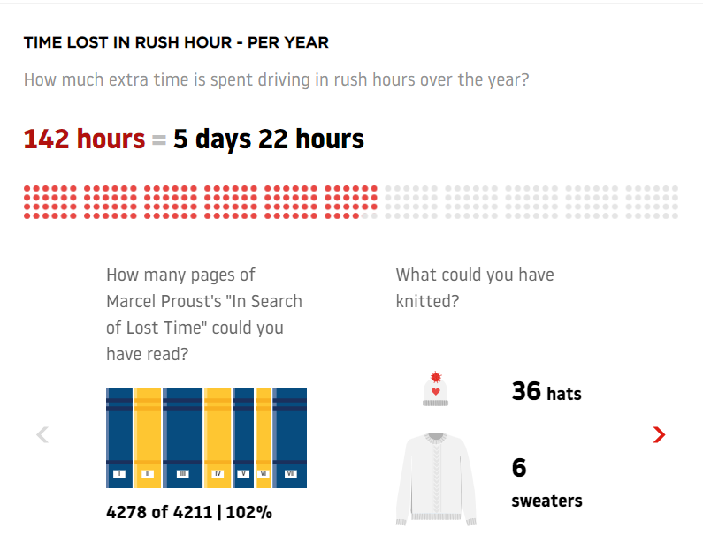
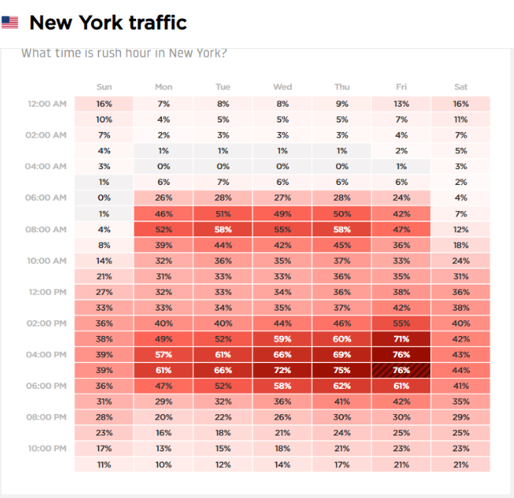
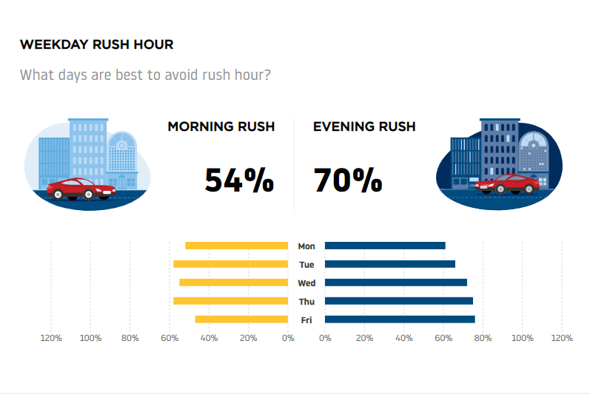
Answer Slide – Rushhour and Traffic Details of NYC : https://www.tomtom.com/en_gb/traffic-index/new-york-traffic/

Slide 80
Answer Slide- Potential Risks Involved
There are defnitely POTENTIAL RISKS (Known & Unknown) that I would highly consider. Some of these were beased on the research being done, and some are purely hypothesis. 1. Safety & Security- (Mechanical/Electrical/Communcations) : Since our industry is extremely new, this specific aspect would be tricky. My hypothesis is that since our technology would be highly based on helicopters, we would need to do further research into the flight safety records of these aerial vehicles. 2. Safety & Security –(Human Factors) – 1 of the reasons why some respondents mentioned that they would not ride any form of ride sharing or some who are doing ride sharing but would never try a flying taxi. Their concern is: How safe am I from the driver? With this, we have to ensure that background checks ranging from police records to bylaw & municipal are regularly updated. I would also highly suggest that we do regular quarterly physical and monthly health checks. I would also highly advocate that driver safety is of paramount importance here. They themselves could also be in ‘potential danger’ from certain types or behaviours of passengers.

Slide 81
Answer Slide- Potential Risks (Continuation)
3. Ongoing Air Traffic Regulations – this is another risk factor that I would highly consider. Once again, a very good hypothesis that I would make is that there will be ongoing regulation changes that our busines shas to deal with. Majority of the rules would be based on the same laws that applies to helicopter pilots and some similar to small aircraft or even drone pilots. 4. Driver Training – Ongoing traning for a flying taxi driver is extremely specialized. This is a known risk that we have to fully consider. We have to make sure that our traning curriculum passes both state/provincial /territorial and federal/national levels. Eventually when our industry goes global, then there would be a global consortium on flying taxi driver licenses.

Slide 82
Answer Slide – Cross Functional Teams
The cross functional teams that I would consider for our MVP are: 1. Legal & Compliance Teams 2. Automotive Engineering (Mechanical, Electrical & Communications) 3. Software Engineering (both for the Flying taxi and the apps/website) 4. Operations Team ( handling the daily manpower and systems, processing) 5. Logistics Team ( may also fall under the Operations Team) 6. Marketing & Business Development ( this is very crucial for a successful MVP) 7. Drivers 8. Mechanics & technicians ( both internal/inhouse AND external/contractual) 9. 3rd Party hardware and mechanical vendors ( copters, other forms of electrical systems) 10. IT / Network Security – very vital not just for the saftety of the Flying taxi’s OS, but also to keep our internal database and prototypes safe and secure. 11. Physical security – security staff ( could be employees or 3rd part security company) that would secure our premises and any other assets that are outside the domain of cyber security 12. Data Engineering team (may inlcude some AI & ML specialists) 13. Analytics & Business Intelligence (could be a ‘sub-part’ of the data engineering team or vice versa 14. Human Resources

